Slide 1
Thermal Draw Tower Concept:
LINEAR ACTUATOR
FEED MOTOR CONTROLLER
FEED RATE
CARRIAGE
Pre-shape preforms to have a conical tip?
FEEDER TC
PREFORM
L_{START}
D_{INPUT}
SET POINT
ELECTRIC HEATER
HEATER CONTROLLER
HEATER TC 1
ARDUINO
HEATER TC 2
Cooling Fans
D_{OUTPUT}
UPTAKE TC
IN-LINE FIBER DIAM DETECTOR
Assuming:
D_{preform} = 20 mm and D_{fiber} = 0.2 mm
Reduction of diameter by 100x
=
Increased length by 10,000x
Therefore:
If v_{feedrate} = 1 mm/s,
Then v_{uptakerate} = 10,000 mm/s
SET POINT
Tensiometer
FIBER COLLECTOR
WIND MOTOR CONTROLLER
UPTAKE RATE
L_{FINAL}

Slide 2
Visual Summary of Thermal Drawing Apparatus Hardware Connections and Software Requirements
Stepper Motor
Velmex X-Slide
(XN-0060-E02-21)
Neg Limit
3D Printed CARRIAGE & CLAMP
Pos and Neg Limit Switches
FEEDER TC (?)
120V AC Wall Socket
+24V_{DC} Power Adapter
24V Power Supply
TB6600 Microstep Driver
Pos Limit
Enable, Direction, Pulse, GND
Motor Wiring
TC 1
ATS Series 3210-2.00 8-4 Furnace
120V AC Wall Socket
Power Cable
Furnace Power
HEATER TC 1
ATS Temperature Control System
Manually Controlled Temperature Setpoint
TC 2
HEATER TC 2
120V AC Wall Socket
+24V_{DC} Power Adapter
KEYENCE LS-9501P
In-Line Controller
Head Cable
UPTAKE TC (?)
KEYENCE LS-9030MT
USB Cable
D_{OUTPUT} Reader
PC USB PORT 2
Analog Output (+/-10V_{DC})
3D Printed Mounts
120V AC Wall Socket
Power Cable
Checkline SC-PM Display Unit
5-Wire Cable
Checkline Tension Sensor
(TS-2L-500-AL)
Tension Reader
5kohm/5kohm Voltage Divider
Analog Output (+0-10V_{DC})
120V AC Wall Socket
Analog Output (+0-5V_{DC})
Pos Limit Read
Pos Limit Write
Neg Limit Read
Neg Limit Write
Power Cable
FilaBot Filament Winder
Speed Control
PC Software Requirements: Arduino IDE – Create microcontroller code loops
LK-Navigator2 – control Keyence in-line detector
Arduino Uno R3

Slide 3
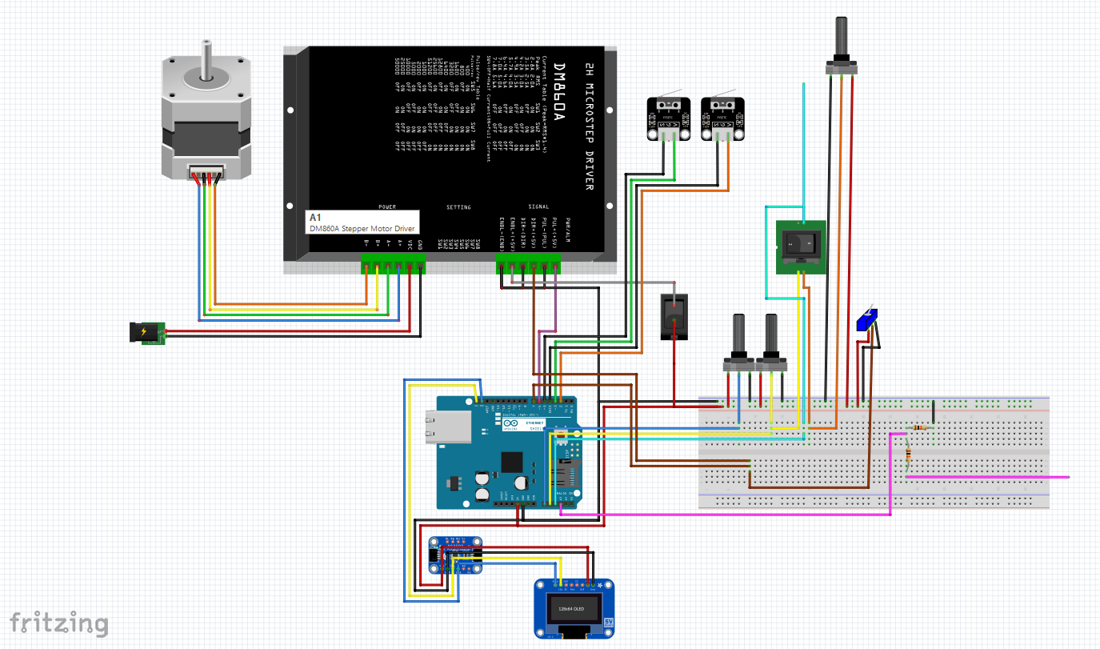
TB6600 Stepper Motor Controller
Limit Switches
Filafab Winder
NEMA 23 Motor
Speed CTRL
Rot Pot 1
Rot Pot 2
Winder Toggle
Direction Mode Selector
Enable
Voltage Divider
+12-24V_{DC} Adapter
Tensiometer
+0-10V Signal
Digi Pot
Feed Speed: X.XX mm/min
Tension: YYY grs
Winder Speed: Z.ZZ m/min
Diameter: WWW um
Tensiometer
+0-5V Signal
OLED Display

Slide 4
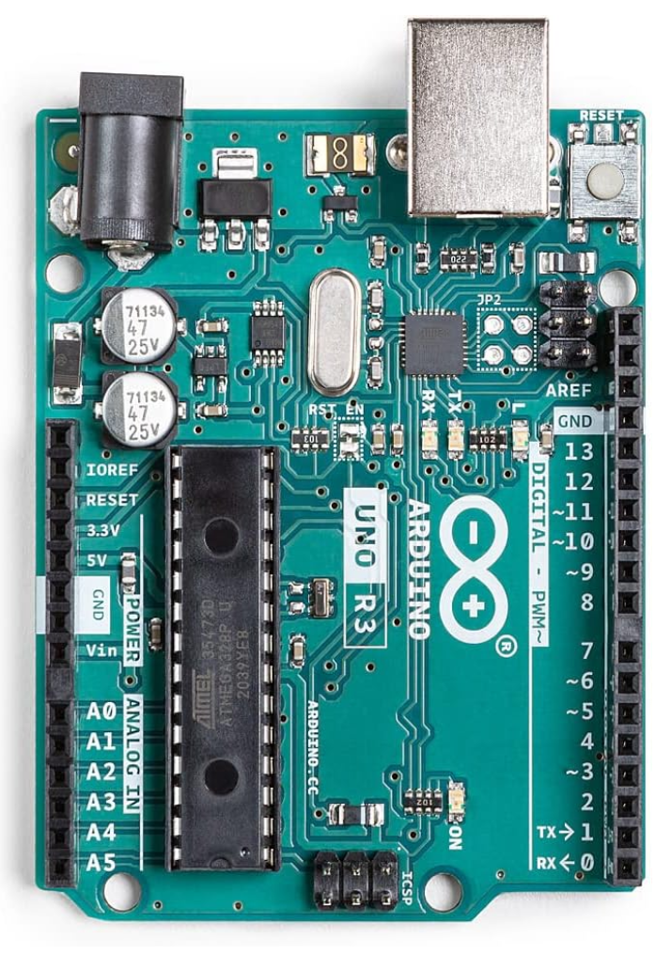
DC Power
USB
I2C SDA
I2C SCL
GND
GND
+5V
GND
FeedMotor DirectionPin
Rotary Potentiometer
FeedMotor StepPin
FeedMotor pos_limit_pin WRITE
Digital Potentiometer
FeedMotor neg_limit_pin WRITE
Tensiometer
FeedMotor neg_limit_pin READ
FILAWINDER
FeedMotor pos_limit_pin READ

Slide 5
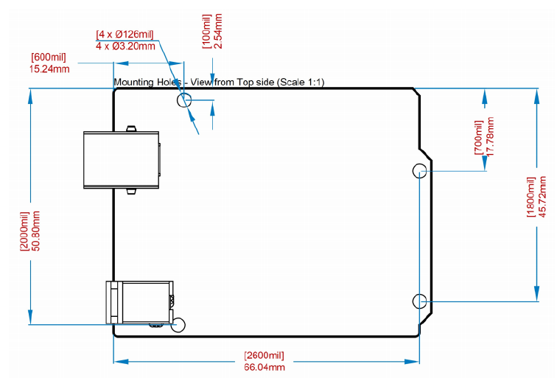
Arduino Uno R3 Board Dimensions

Slide 6
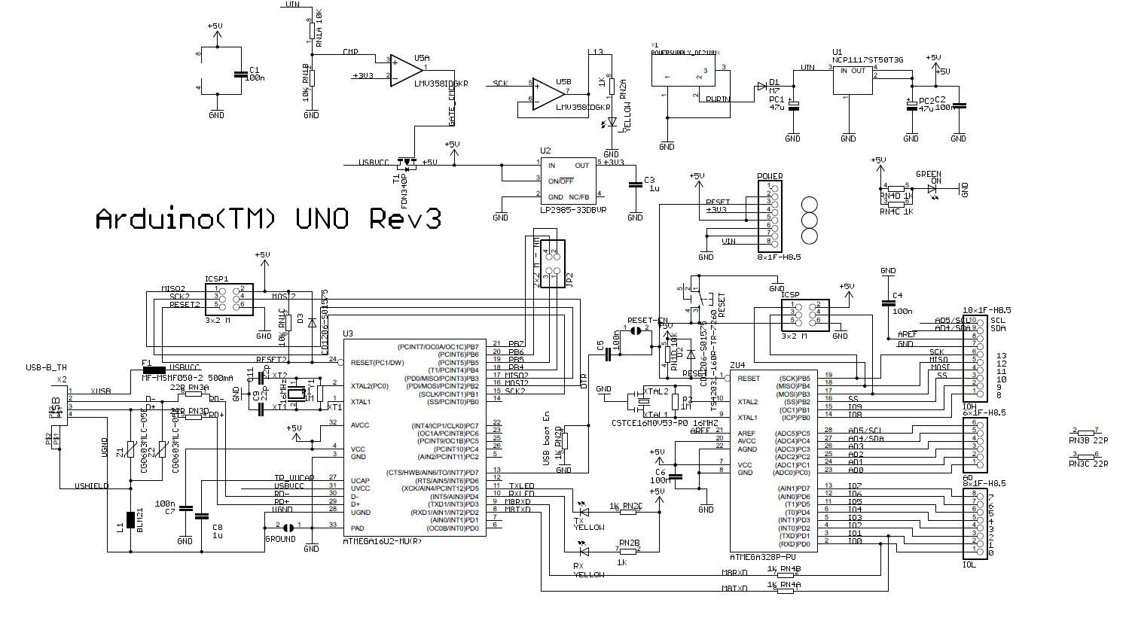
Arduino Uno R3 Electrical Schematic

Slide 7
Motor Speed Calculation
Velmex X-Slide E02 screw pitch = 0.200” = 5.08 mm per revolution
TB6600 Microstep Driver:
DIP switches {1-2-3} set to {OFF-OFF-ON} for 3200 steps per revolution
DIP switches {4-5-6} set to {OFF-OFF-ON} for 2.8A of supply current
5080 um / 3200 steps = 1.6 um / step
Pulse delay rpm_t = 60,000,000 us / 2 pauses / _pulse / _rpm
For pulses = 3200 and RPM = 1, rpm_t = 4,687.5 us/pause

Slide 8
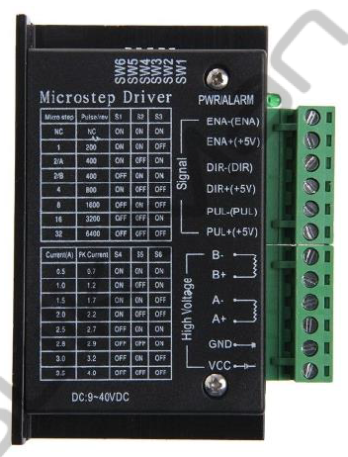
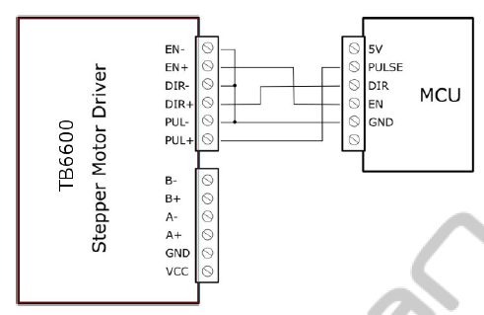
TB6600 Microstep Driver
Controls a unipolar stepper motor by use of 24V external power supply and microcontroller triggering
Pin connections:
Ena + : Digital Pin 12
Dir + : Digital Pin 11
Pul + : Digital Pin 10
Ena -, Dir -, Pul - : Digital Ground
A+/-, B+/- : Motor wires
GND : Power Supply Ground
V_{CC} : +24 V_{DC}
6 DIP switches allow selection of various steps/revolution and sets supply current (details on next slide)

Slide 9
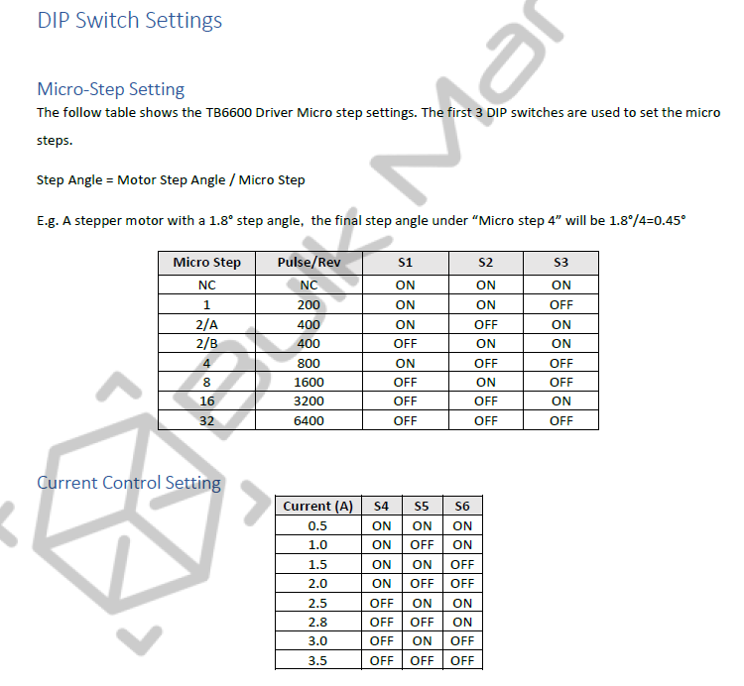
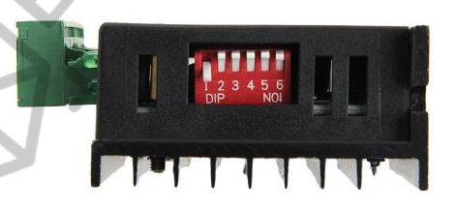
OFF|OFF|ON|OFF|OFF|ON
3200 steps per revolution
Nema 23 motor current = 2.8A

Slide 10
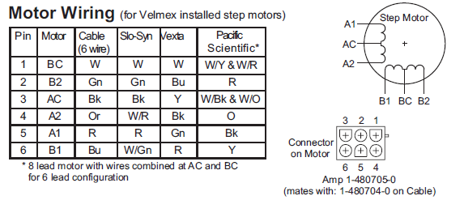
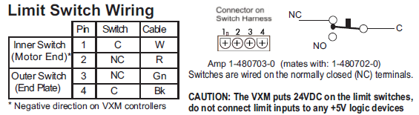
1 – BLUE – C (GND)
2 – BLACK – NC (INT)
----
3 – WHITE – NC (INT)
4 – GREEN – C (GND)

Slide 11
AccelStepper.h Library
AccelStepper.feedmotor(AccelStepper::DRIVER (interface), step_pin, dir_pin)
Return the carriage to the top starting point by pressing both switches to enable the software loop, then press the bottom (positive) limit switch to reverse the direction of the run() command and over-ride the user set feed speed with the maximum. This should run until the top (negative) limit switch is triggered, at this point the motor should be stopped, the direction reversed and then moved down a couple full rotations (approx. 5mm per revolution; 3200 steps per revolution)

Slide 12
Initialize Settings and Display
Update Settings based on user inputs
runSpeed()
updateDisplay()
limitSwitch()
If BOTH limit switches are being triggered together: user initiating software
If EITHER limit switch is hit while the OTHER is not: stop motor & reverse direction
If NEITHER limit switch is being triggered: carriage should run at set speed (user or software)
While the limit switches are triggered, without some reverse movement, they will stay triggered and never enter the NEITHER condition
Reverse direction()

Slide 13
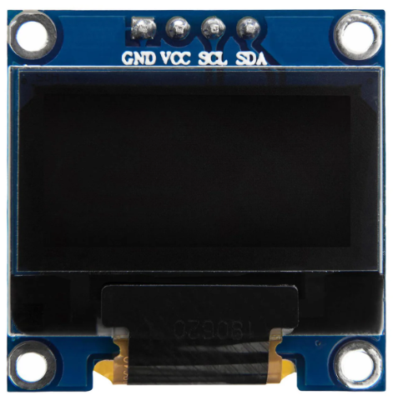
SSD1306 OLED Display – I2C
Provides real-time text readouts of process settings such as feed speed, uptake speed, tension, diameter, etc.
Pin connections:
GND : GND
VCC : +5 V
SCL : SCL Comm Bus
SDA : SDA Comm Bus
SDA
SSD1306
OLED Display 128x64
SCL
+5V
GND

Slide 14
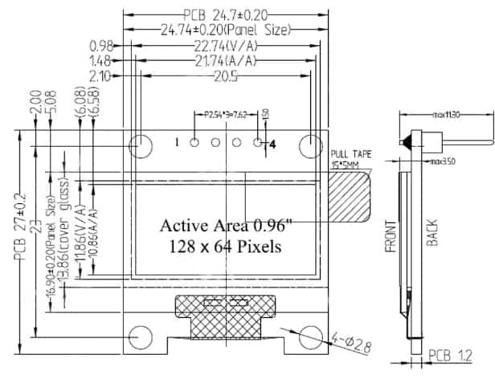
SSD1306 OLED Display Dimensions

Slide 15
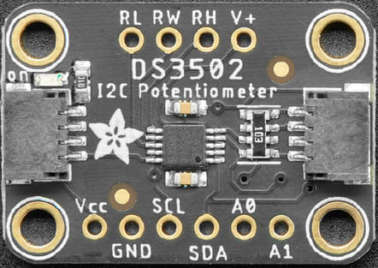
DS3502 Digital Potentiometer – I2C
Digitally controls analog wiper pin RW from 0 – 5 V
Pin connections:
RL, GND : GND
RH, V_{CC} : +5 V
RW : Analog I/O Pin A0
SCL : SCL Comm Bus
SDA : SDA Comm Bus
V+, A0, A1 : No Connection
SDA
DS3502
Digital Potentiometer
SDA
SCL
SCL
+5V
+5V
GND
GND

Slide 16
Uptake Motor and Spoolage
Need an uptake motor capable of moving at the necessary RPMs for the effective spooling of drawn fibers
Assuming the final diameter is 100X smaller than the input diameter, the uptake motor should wind at approximately 100X the feed motor
Not sure whether a stepper motor is ideal here or if a DC motor controlled by the digital potentiometer would be better

Slide 17
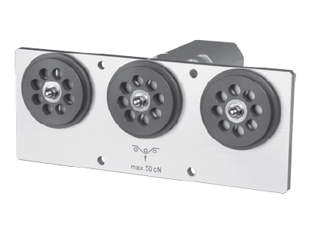
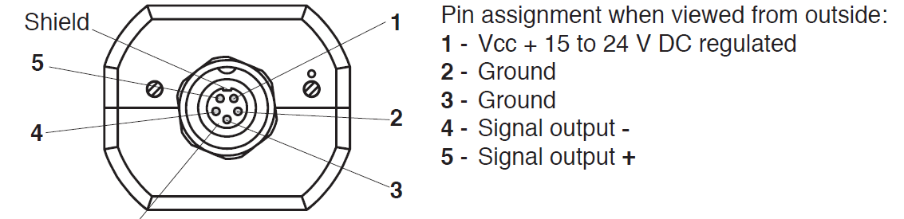
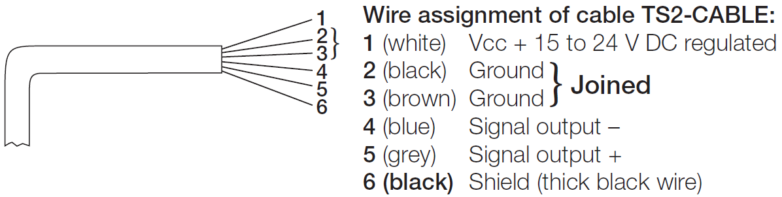
Checkline TS2L-500 Tensiometer
0 – 500 g measuring range (too high) probably
Connects by cable to display unit
Pin and Wire Connections:

Slide 18
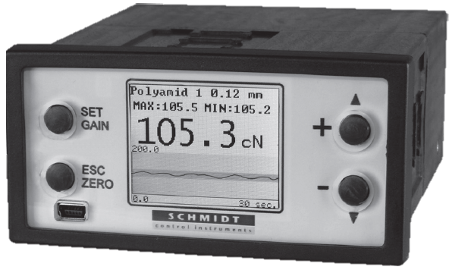
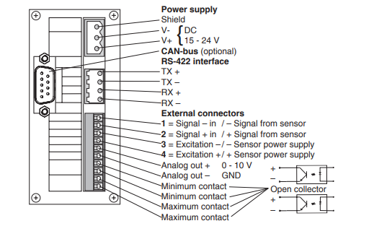
Checkline SC-PM Display Unit
Connects to a 24 V_{DC} wall-socket power adapter and the 5-wire cable
N/A
Analog Signal Out (+) pin supplies 0 – 10 V
Use a voltage divider to reduce the signal range to 0 – 5 V so that it is acceptable for Arduino
Connect to an Analog I/O pin on the Arduino Uno R3

Slide 19
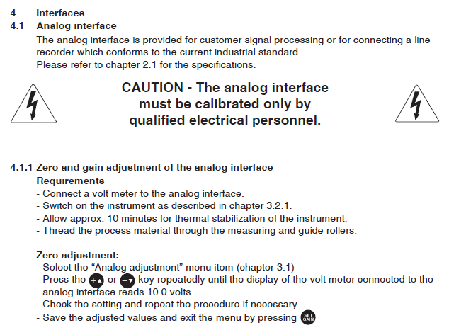
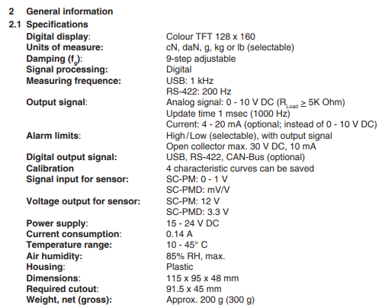
Tensiometer Interface

Slide 20
Keyence In-Line Diameter Measurement
Mounted into position below the furnace to measure the output fiber diameter
Output diameter could be a quality control metric independent of the restof the system
Or, the output signal could be used to feed back into the Arduino to adjust the process to increase/decrease uptake/feed rate based on the measured value
Set up a measurement program using the Keyence software (LS-Navigator2), including necessary steps to enable signal collection using the analog outputs *(note: these necessary steps will need to be determined at the time of implementation.)

Slide 21
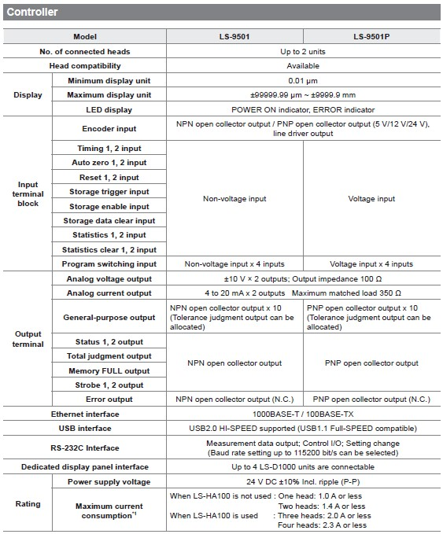
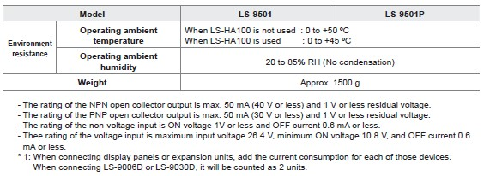

Slide 22
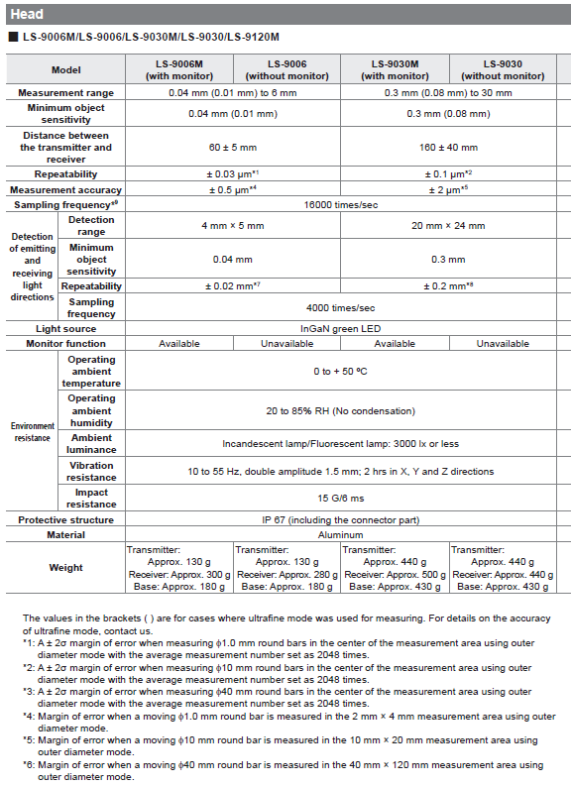

Slide 23
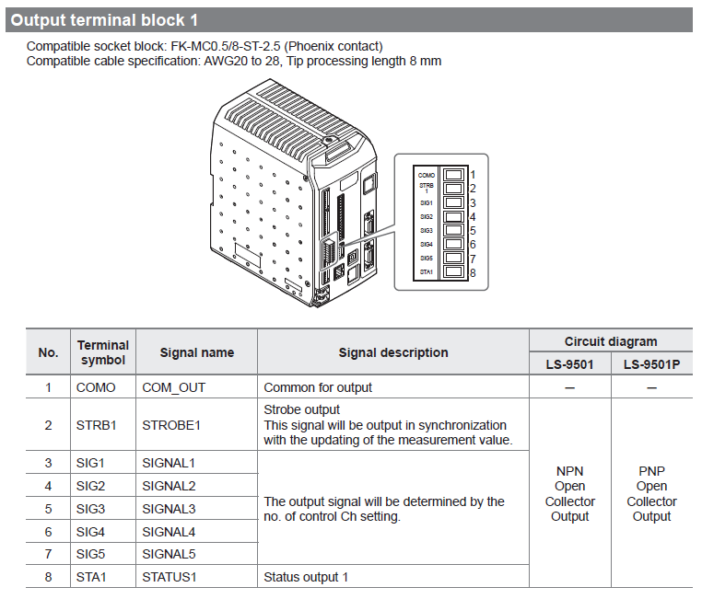

Slide 24
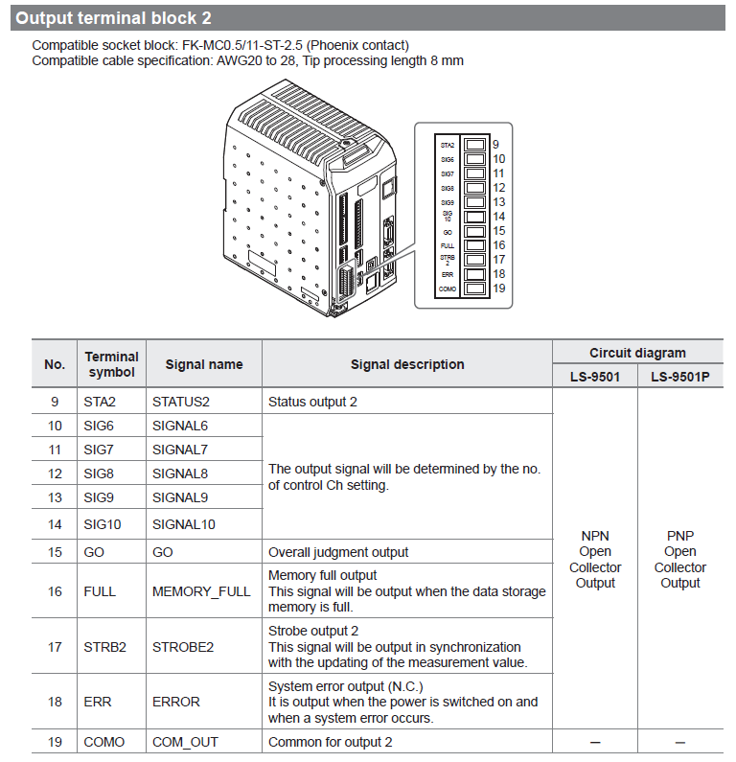
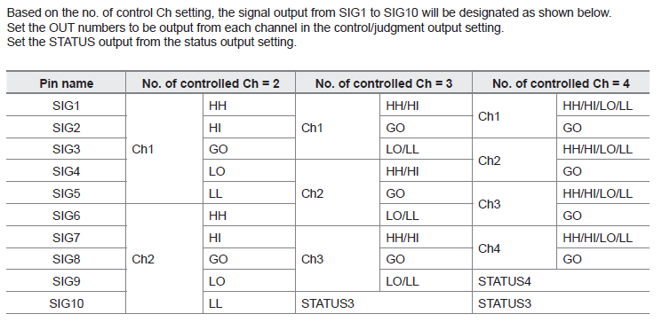

Slide 25
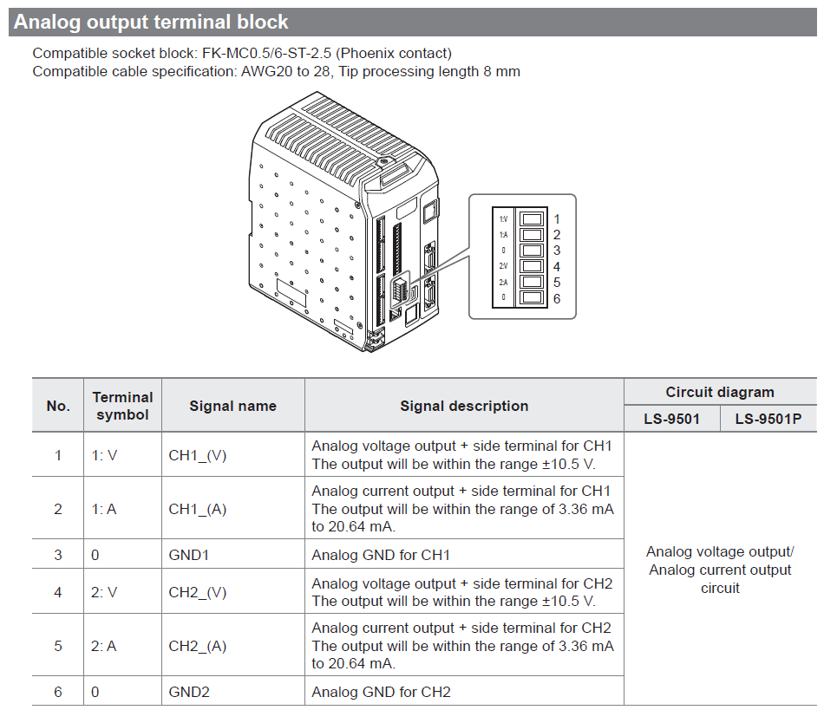

Slide 26
Feed Speed
Feed Dir
FEED SPEED: WIND SPEED:
DIAMETER: TENSION:
On/Off
Wind Speed
Wind Ctrl Mode
BACK FACE
6-pin Connector
o|G|T|3|4|o
Cable Hole

Slide 27
Updated Controls, 2024-December-03
Feed Dir
Feed Speed
On/Off
M
FEED SPEED: WIND SPEED:
DRAW RATIO:
DIAMETER:
L
R
Feed Dir Switch Options:
L:
M: Automatic mode (leave in this position)
R:
Wind Ctrl Mode Options:
L: Winder speed controlled by drive knob on the winder unit itself
R: Winder speed controlled by arduino
Wind Ctrl Mode
Wind Speed
L
R
BACK FACE
6-pin Connector
o|G|T|3|4|o
Cable Hole

Slide 28
MATERIALS
Low-Density Polyethylene (LDPE)
Thermoplastic made from ethylene
C2H4)n
917-930 kg/m³
Can handle temps of 65C consistently and 90C briefly
Less crystalline than HDPE
High-Density Polyethylene (HDPE)
Thermoplastic made from ethylene
930-970 kg/m³
Polypropylene (PP)
Thermoplastic polymer from propylene
C3H6)n
Polyethylene Terephthalate Glycol (PETG)
Polylactic Acid (PLA)
Styrene-Ethylene-Butylene-Stryrene (SEBS)
Thermoplastic elastomer

Slide 29
Low-Density Polyethylene (LDPE)
Density | 0.88 – 0.96 g/cm³
Melting point | 115 – 135°C
Glass Transition Temperature | °C
Temperature of crystallization | °C
Latent heat of fusion | kJ/kg
Thermal conductivity | W/m-K
Specific heat capacity | J/kg-K
Specific heat (solid) | kJ/kg-K
Crystallinity | %

Slide 30
High-Density Polyethylene (HDPE)
Density | 961 kg/m³
Melting point | 131.8 °C.
Temperature of crystallization | 121.9 °C.
Latent heat of fusion | 188.6 kJ/kg.
Thermal conductivity | 0.54 W/m.°C. at °C.
Specific heat capacity | 1331 to 2400 J/kg-K
Specific heat (solid) | 2.9 kJ/kg. °C.
Crystallinity | 61%

Slide 31
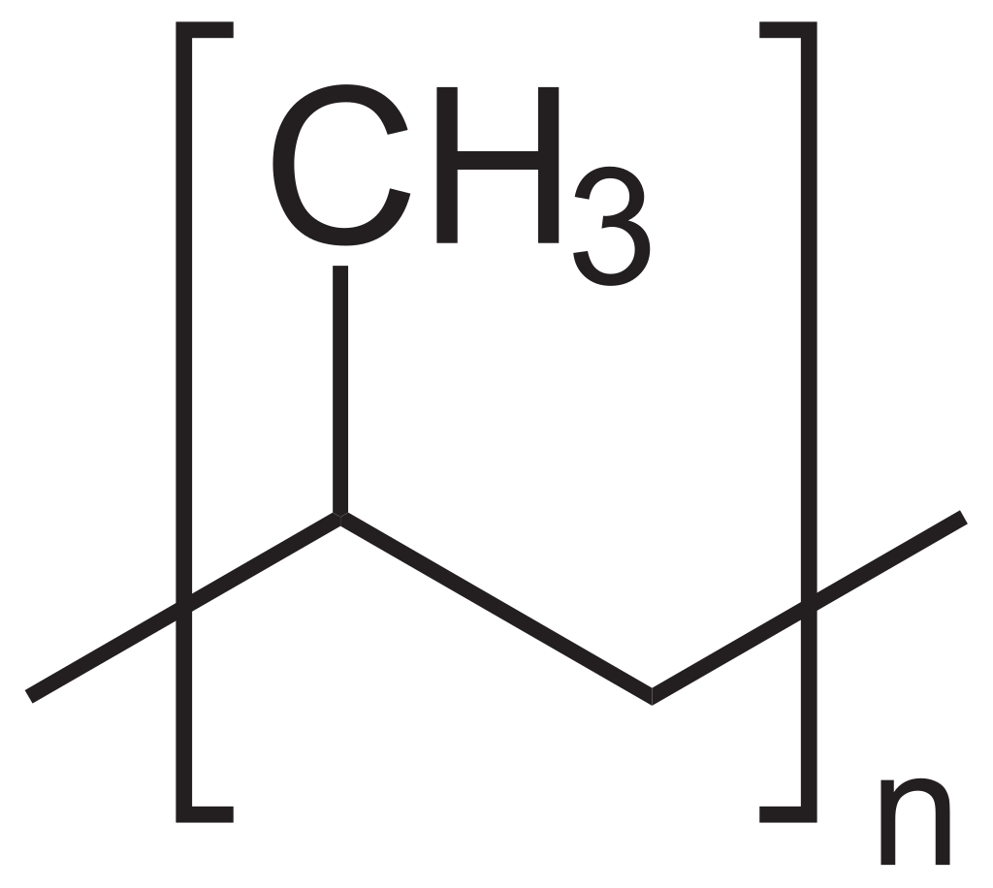
Polypropylene (PP)
Density | 0.855 g/cm³ (amorphous) 0.946 g/cm³ (crystalline)
Melting point | 130 – 171°C
Glass Transition Temperature | -10°C (amorphous, atactic) -8°C (semi-crystalline, syndiotactic) 0°C (semi-crystalline, isostatic)
Temperature of crystallization | °C
Latent heat of fusion | kJ/kg
Thermal conductivity | W/m-K
Specific heat capacity | J/kg-K
Specific heat (solid) | kJ/kg-K
Crystallinity | %
Notes:
https://en.wikipedia.org/wiki/Polypropylene

Slide 32
Polylactic Acid (PLA)
Density | kg/m³
Melting point | °C
Glass Transition Temperature | °C
Temperature of crystallization | °C
Latent heat of fusion | kJ/kg
Thermal conductivity | W/m-K
Specific heat capacity | J/kg-K
Specific heat (solid) | kJ/kg-K
Crystallinity | %

Slide 33
Polyethylene Terephthalate Glycol (PETG)
Density | kg/m³
Melting point | °C
Glass Transition Temperature | °C
Temperature of crystallization | °C
Latent heat of fusion | kJ/kg
Thermal conductivity | W/m-K
Specific heat capacity | J/kg-K
Specific heat (solid) | kJ/kg-K
Crystallinity | %

Slide 34
Styrene-Ethylene-Butylene-Styrene (SEBS)
Density | kg/m³
Melting point | °C
Glass Transition Temperature | °C
Temperature of crystallization | °C
Latent heat of fusion | kJ/kg
Thermal conductivity | W/m-K
Specific heat capacity | J/kg-K
Specific heat (solid) | kJ/kg-K
Crystallinity | %

Slide 35
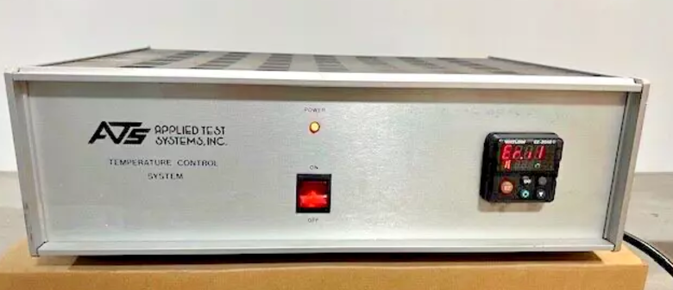
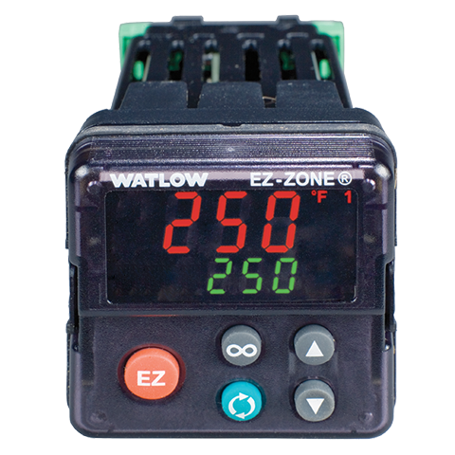
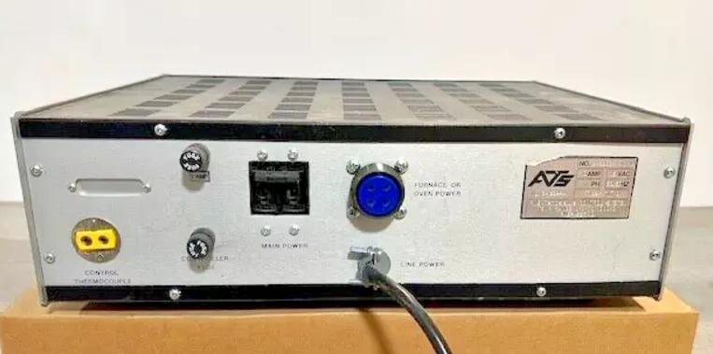
ATS Furnace Temperature Controller
Current temperature
Power On
Target temperature
Adjust target
Power On
(Safety)

